Slide 1
Multiple Units [LOS2]
By Python
ALLPPT.com _ Free PowerPoint Templates, Diagrams and Charts

Slide 2
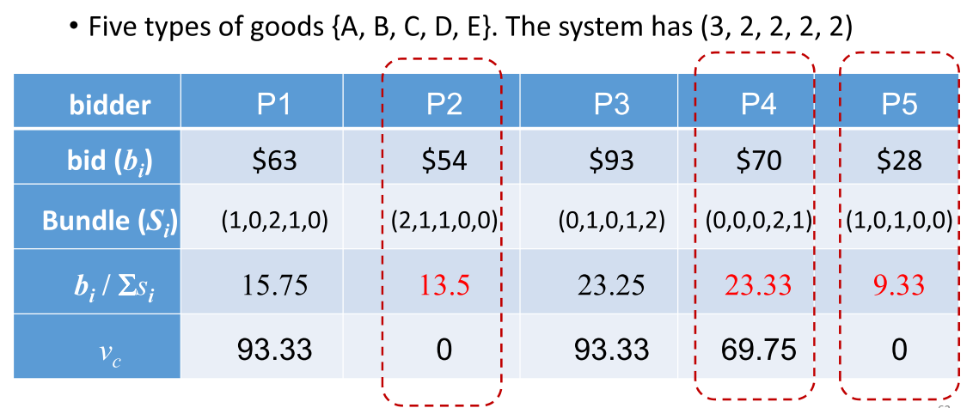
Example
14.00

Slide 3
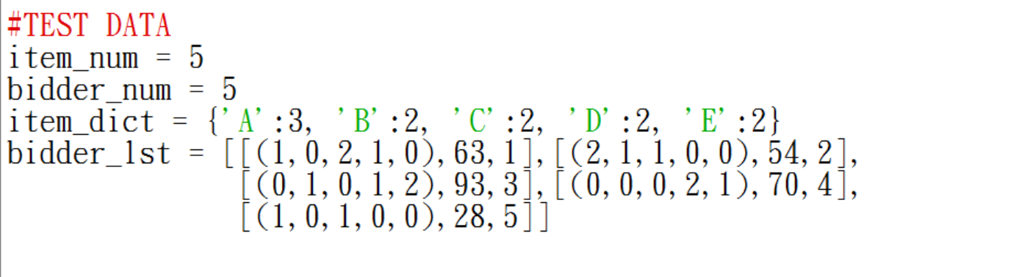
Data
Item_dict = { 物品:數量 }
Bidder_lst = [ Bundle, Bid, Name ]

Slide 4
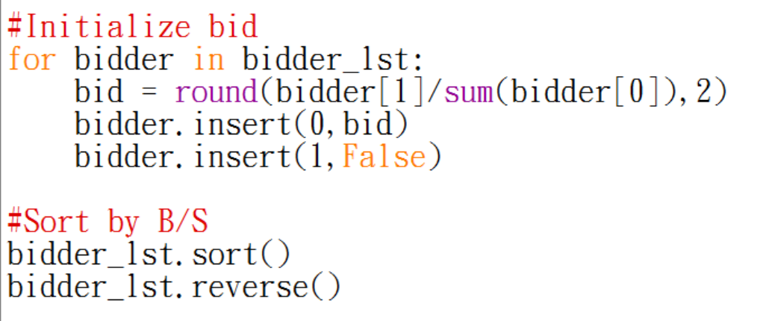
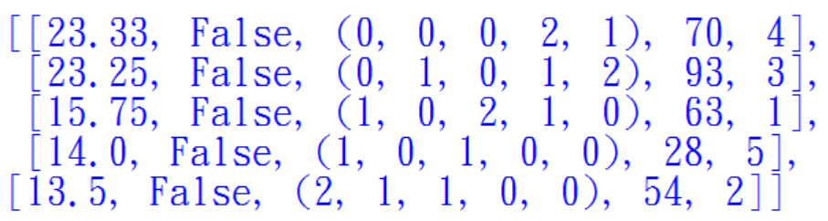
Initialize
[ B/S,CV,Bundle, Bid, Name ] ← Bidder_lst

Slide 5
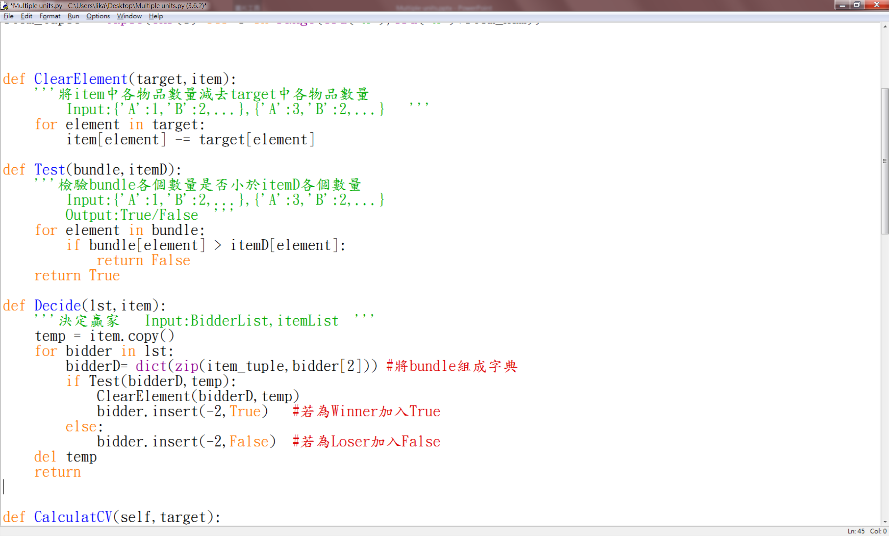
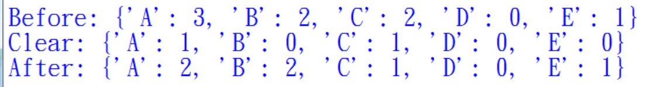
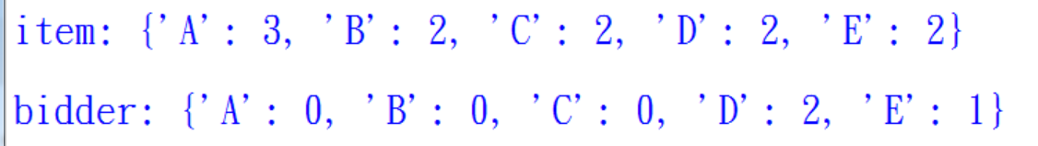
Decide Winner

Slide 6
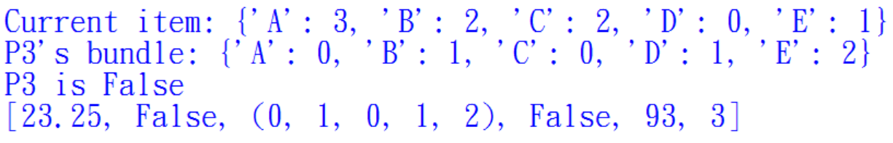
Decide Winner
[ B/S,CV,Bundle, Bid, Winner, Name ] ← Bidder_lst

Slide 7
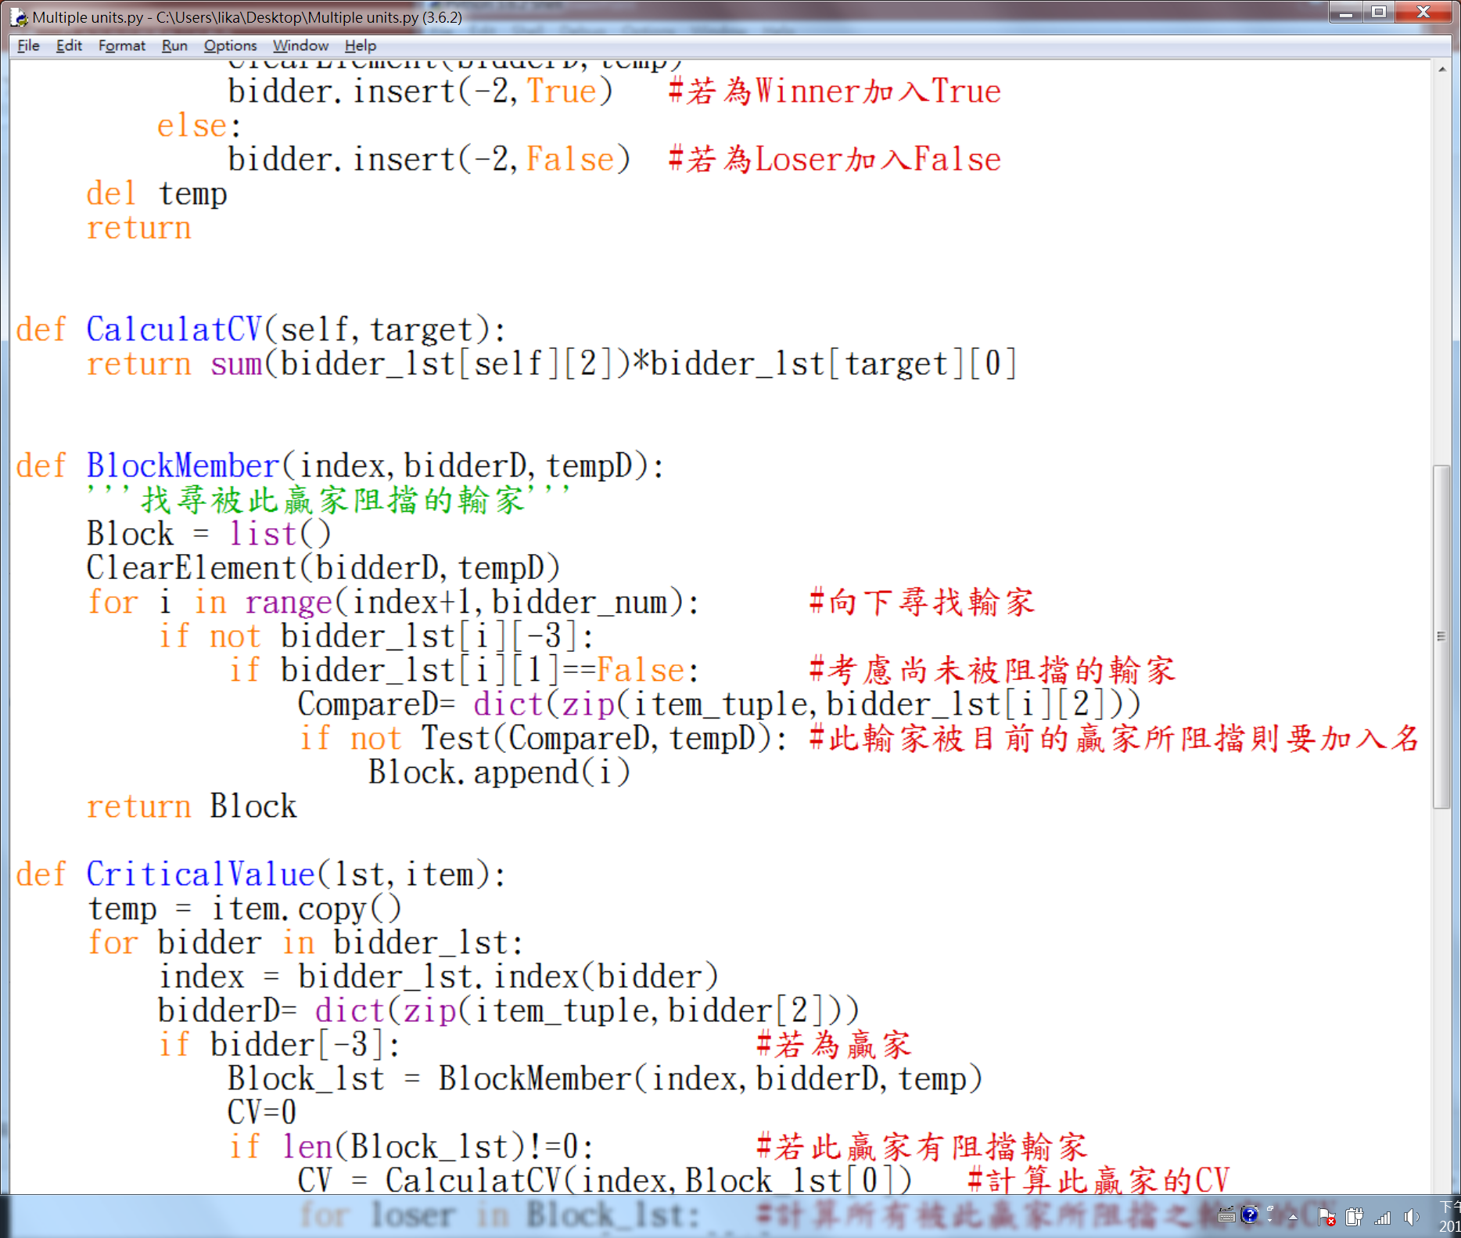
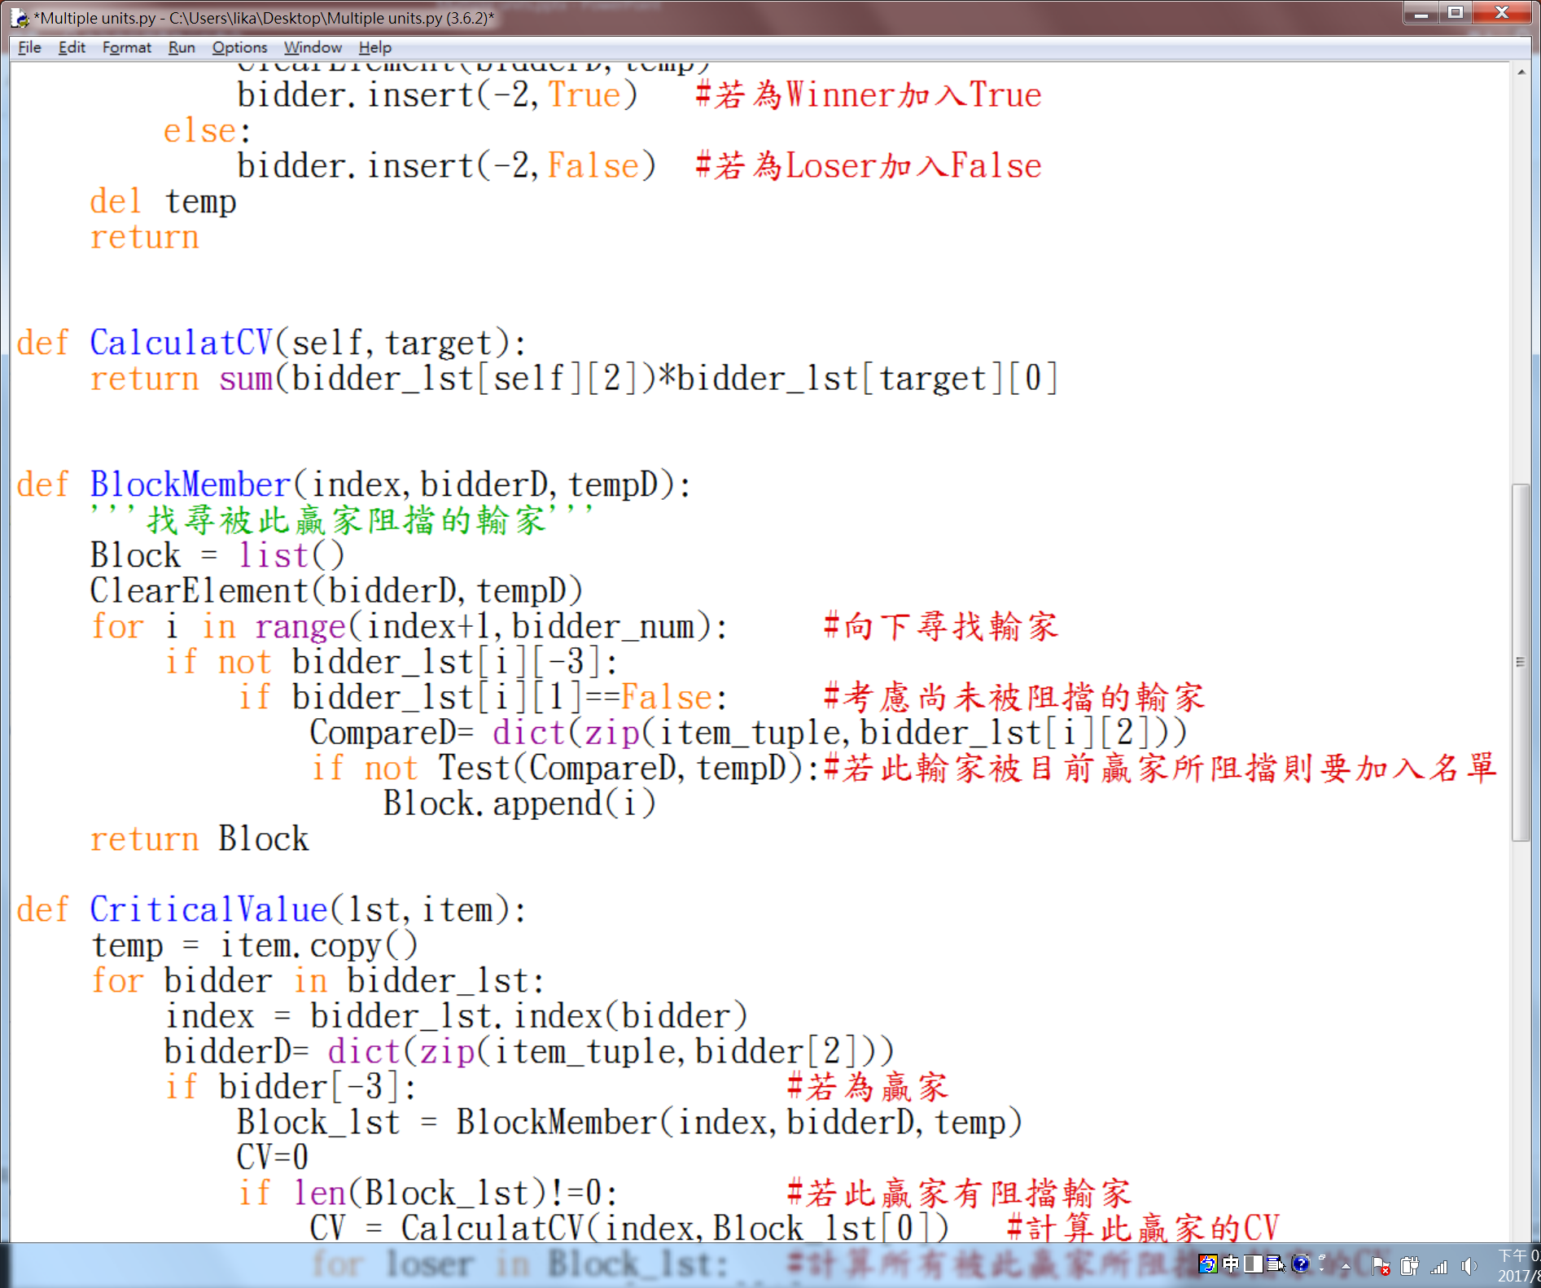
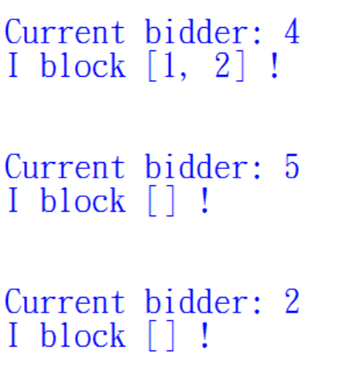
Critical Value

Slide 8
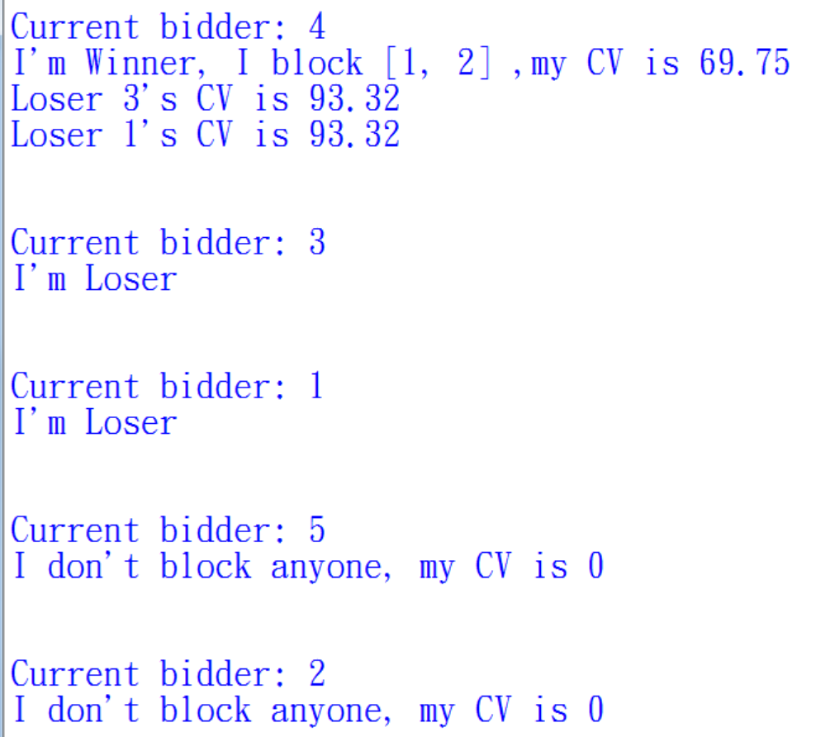
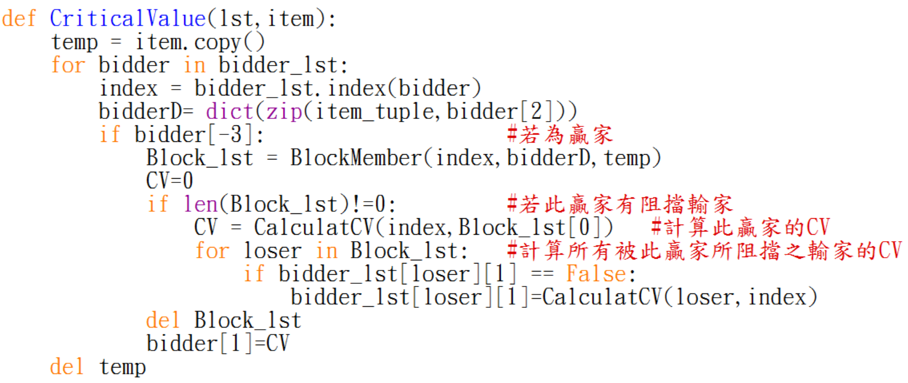
Critical Value

Slide 9
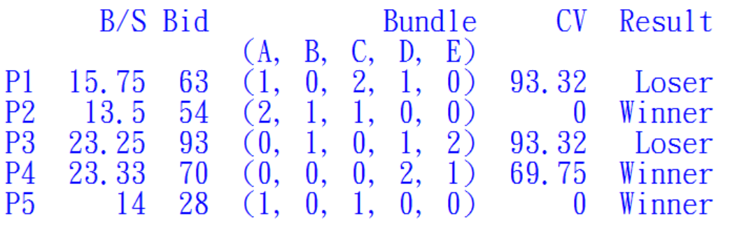
Result

Slide 10
Another example
✔
✔
✔
bidder | P1 | P2 | P3 | P4 | P5
bid (b_{i}) | $63 | $90 | $93 | $70 | $50
Bundle (S_{i}) | (1,0,2,1,0) | (2,1,1,0,0) | (0,1,0,1,2) | (0,0,0,2,1) | (1,0,1,0,0)
b_{i} / Σs_{i} | 15.75 | 22.5 | 23.25 | 23.33 | 25.00
v_{c} | 100 | 0 | 93.33 | 69.75 | 31.5

Slide 11
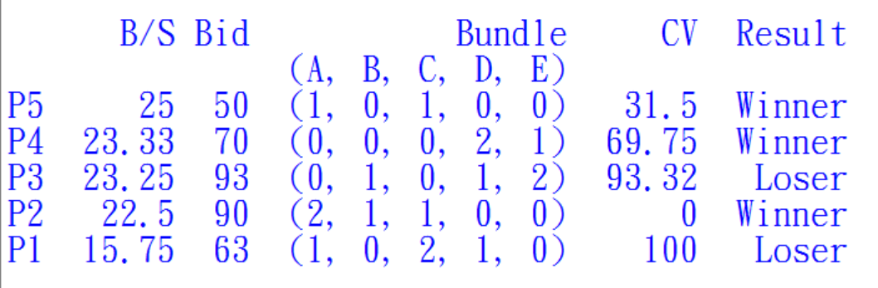
Another example

